Slide 1


ANALYTICS SHOWCASE
What makes a loyal customer?
PREPARED BY NATE SMITH & KAITLYN COMMES

Slide 2



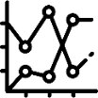

Agenda
Initial Look
Further Analysis
1
3
2
4
Machine Learning
Suggestions

Slide 3

Initial Look
361,559
total rows of data
34%
of buyers have subsequent purchases
Missing Data
Post Satisfaction Survey (360,340)
Feature dropped from all records
Customer Income (49,091)
Missing fields filled with median
Customer Gender (35,758)
Distribution of non-nulls used to fill
Distance to Dealer (6,162)
Distribution of non-nulls used to fill
All records with this field missing had exactly one subsequent purchase
Customer Age (1,154)
Missing fields filled with median
Purchase Price (3)
Records with missing field dropped

Slide 4
Initial Look – Data Classifications
Nominal | Boolean | Ordinal | Integer
Provided: Vehicle make Vehicle model | Provided: Customer gender Previous purchase Trade-in Use of warranty Vehicle financing | Provided: [none] | Provided: Customer age Customer income Distance to dealer Purchase price Vehicle year
Derived: Vehicle market classification (luxury, mid-range, low-end, budget) | Derived: Distance missing Gender missing Income missing | Derived: Binned distance (<1 mile to 2500 miles, uneven bin sizes) | Derived: Relative vehicle make popularity

Slide 5
Loyal =
Any customer with non-zero subsequent purchases

Slide 6
Data Distributions

Slide 7

Feature Distributions – Customer Data

Slide 8
Feature Distributions – Customer Data

Slide 9
Feature Distributions – Vehicle Data

Slide 10
Feature Distributions – Vehicle Data

Slide 11
Feature Distributions – Dealership Data

Slide 12
Statistical Processing & Machine Learning

Slide 13
Overview
1
Univariate Statistical Testing
Filtering out features that do not have a significant effect on loyalty before modeling
Machine Learning Algorithms
Determining relative feature importance and viewing overall predictive power
2
Pairwise Feature Heatmaps
Diving deeper into the interactions between the most significant features
3
Insights and Suggestions
Translating data findings into actionable steps for improving customer loyalty
4

Slide 14
Univariate Statistical Testing
Summary of Approach
Compares features individually
Determines if relationship with response is significant
Data separated by variable type
Categorical
Chi-squared test
Loyalty indicator
Integer
Kendall’s tau correlation
Subsequent purchases
Variable | Chi^2 | Kendall Tau | P-Value
Distance_missing | 11869.86 | - | 0
Customer_previous_purchase | 698.35 | - | 6.4x10⁻¹⁵⁴
Trade_in | 365.46 | - | 1.8x10⁻⁸¹
Purchase_vehicle_year | - | -0.0186 | 1.8x10⁻⁴⁰
Customer_income | - | -0.0189 | 1.2x10⁻³⁹
Vehicle_warranty_used | 133.00 | - | 9.0x10⁻³¹
Vehicle_financing | 93.31 | - | 4.5x10⁻²²
Income_missing | 82.11 | - | 1.3x10⁻¹⁹
Purchase_make | 70.70 | - | 4.4x10⁻¹⁹
Purchase_price | - | -0.0114 | 5.1x10⁻¹⁵
Customer_gender | 60.20 | - | 8.6x10⁻¹⁵
Customer_distance_to_dealer | - | -0.0082 | 1.4x10⁻⁹
Purchase_model | 31.20 | - | 2.3x10⁻⁸
Make_popularity | - | -0.0071 | 2.2x10⁻⁷
Distance_binned | 25.74 | - | 3.9x10⁻⁷
Gender_missing | 3.95 | - | 0.047
Purchase_make_cat | 3.03 | - | 0.082
Customer_age | - | -0.0003 | 0.819

Slide 15
Overview & Preparation
Random Forest machine learning using all the features was leveraged
Branching algorithms can tell us feature importance's
Feature importance's tell which features were the most influential on predictions and can help narrow analysis

Slide 16
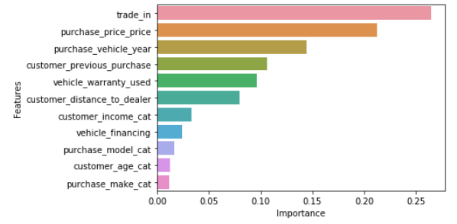
Conclusions/Comparing Results
Explanation of features

Slide 17
Further Analysis & Suggestions

Slide 18
(niche cars)
Overall average loyalty rate

Slide 19
(niche cars)
Overall average financing rate

Slide 20
Customers purchasing rare cars, both budget and luxury, have higher rates of loyalty.
Use targeted online marketing to advertise rare & luxury car availability at fair prices.

Slide 21
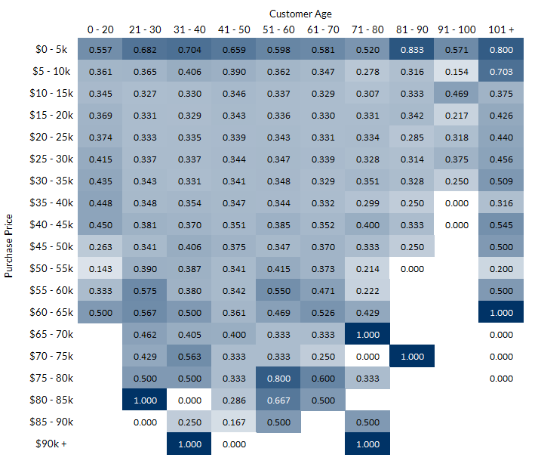

(later slide – age and purchase price)

Slide 22
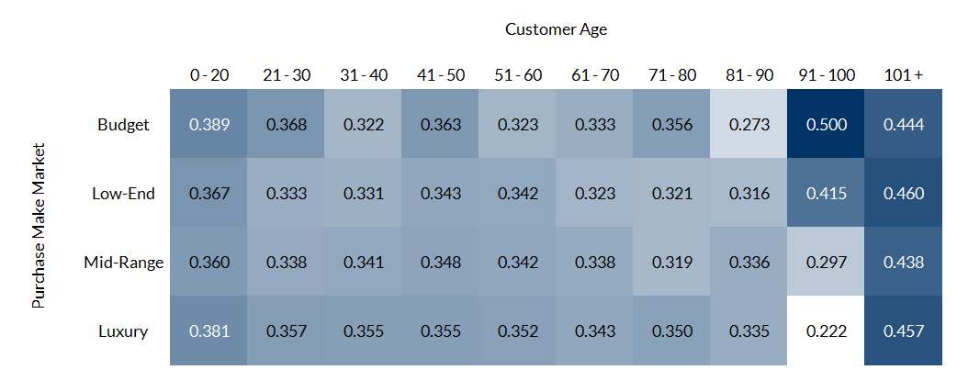
(later slide – possible alternative to above slide, easier to look at but tells a little less)

Slide 23
Insight 2
Suggestion 2

